Slide 1
Object Oriented Javascript
- By Arun Rajthala

Slide 2
Components
Global Variables -lifetime spans program execution.
Local Variables - lifetime limited to execution of a single routine.
Static Variables - visible in single scope
Nested Scopes - allow functions to be local.
Modules - allow several subroutines to share a set of static variables.

Slide 3
Object
An object is a thing
More precisely, an object is a representation of a thing
Has characteristics
We call these "attributes" or "properties"
Properties are just variables rebranded!
Those things which the thing has
Has behaviors
We call these "methods"
Methods are just functions rebranded!
Those things which the thing does

Slide 4
Encapsulation
Treat each object as a black box
Well-defined interface of data and methods
Must use this interface in the application
All data is private
Methods can be public, private, or protected

Slide 5
Inheritance
Defines subclasses
Creates “is a” relationship
Example: Camera phone “is a” cell phone
Reuse common functionality
Specialization
Extend or override common functionality for specific needs

Slide 6
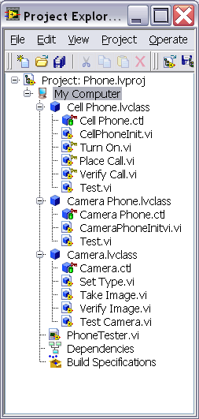
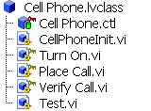

Mechanism
Parent Class
Classes and objects
Encapsulation
Child Class
Inheritance
For power programmers and large-scale application development

Slide 7
Benefits
Promotes code reuse
Reduces code maintenance
Simplifies extending applications

Slide 8
Thank you
Questions???

